Slide 1
Phylogenetic Analysis

Slide 2
Steps in Phylogenetic Analysis
The Phylogenetic Analysis is in general four Step Method:
Alignment strategy
Determination of the substitution model
Tree Building
Tree Evaluation

Slide 3
Continue…..
For n sequences ,the number of possible tree is given in following table
# of sequences n | #of trees
3 | 1
4 | 3
5 | 15
6 | 105
7 | 945
8 | 10,395
9 | 135,135
10 | 1,027,025
50 | 2.8*10^74

Slide 4
Methods of Phylogenetic Analysis
There are two main categories of Phylogenetic analysis
Distance Method
All possible pairs of sequences are aligned.
Character Methods
There are basically two types
Maximum Parsimony Method
Maximum Likelihood Method

Slide 5
Character Method
Maximum Parsimony Method
Multiple Sequence alignment is produced to predict which alignment positions are likely to correspond.
Position will appear in vertical column in multiple sequence alignment.
For each aligned position Phylogenetic trees are generated.
those tree which produce smallest no of changes overall for all sequence are identified.

Slide 6
Continue..
2. Maximum likelihood Method
Depends upon the first obtaining reliable multiple sequence alignment
Examine the changes in each column in the alignment.
likelihood of particular tree miscalculated using expected model of changes in the sequences.
For each tree the likelihood of finding the actual sequence changes at each column in the aligned sequence is calculated.
The probability for each aligned position are then multiplied to provide likelihood for each tree.
the tree that provide max. likelihood value is the most probable tree.

Slide 7
Step 1: Alignment Strategy
The aim is to reduce the problem of a multiple alignment to an iteration of pairwise alignment.
Compute all pairwise distance between given seuquences.
Compute a tree by single linkage clustering
Align the seuquences in bottom up order

Slide 8
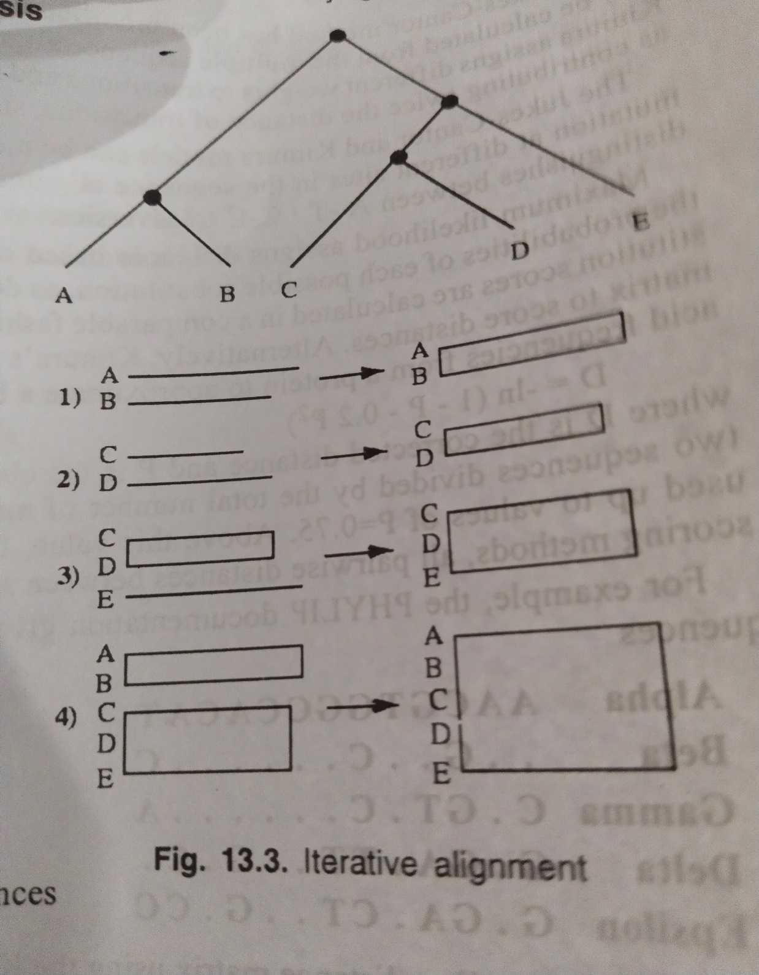

Slide 9
Continue..
Advantages:
Profile alignment reflects the conservation within a group.
It’s fast and scales to large no of sequences.
Disadvantage:
Unlcear objective function
Misalignment introduced during the procedure are kept.

